Slide 1
The Beatles
By : Sindhura Shetty
Pradwin
Sheikh Mohammed Shuhood
Rathan Nayak

Slide 2
INTRODUCTION
Employee Assistant & Tracker" stands at the forefront of workplace innovation, offering a transformative experience that goes beyond conventional paradigms. At its core, this pioneering project is an integration of two powerful components: a robust Community System and an advanced Employee Tracker. These elements work in tandem to reimagine the way we perceive and navigate the modern professional landscape.

Slide 3
PROBLEM STATEMENT
In remote workplaces, the lack of an efficient and secure system for internal knowledge sharing and collaboration between employees is a major challenge. Current communication channels often lack features that encourage active engagement, hinder the transparent exchange of work-related issues and jeopardise the security of confidential information. The lack of a structured recognition system also dampens employees' motivation to actively contribute knowledge. Furthermore, there is a need for a comprehensive management tool that allows administrators to monitor and evaluate the individual performance of employees within such a collaborative platform. Addressing these challenges is essential to fostering a culture of knowledge sharing, ensuring data security and increasing the overall efficiency of the workforce.

Slide 4
APPROACH
Database setup with Firebase:
Start by setting up Firebase as the backend database. Configure the required collections for employee data, queries, responses and administrative information.
User Authentication:
Implement Firebase authentication to manage user credentials and logins. Ensure that only registered employees can access the platform.
Implement the Admin Panel:
Develop an admin panel using Django to give the administrator exclusive access to add and manage employee accounts. Use the Django administration interface to simplify this.

Slide 5
APPROACH
Dashboard for employees:
Direct them to a personalised dashboard after logging in, with options to add requests or respond to existing requests.
Mechanism for submitting and responding to requests:
Design intuitive interfaces for your employees to submit requests and provide responses. Use JavaScript to dynamically process forms and interactions. Use the Firebase Realtime Database for instant updates.
Contribution tracking and analysis:
Implement a mechanism to track and store contributions. Create a dashboard for the administrator to visualise employee contributions.

Slide 6
APPROACH
Backend development with Python and Django:
Set up the backend server with Python and Django.
Frontend development (HTML, CSS, JavaScript):
The frontend is developed using HTML for structure, CSS for styling and JavaScript for dynamic behaviour,to ensure a responsive design for a seamless user experience on different devices.

Slide 7
APPROACH
Backend development with Python and Django:
Set up the backend server with Python and Django.
Frontend development (HTML, CSS, JavaScript):
The frontend is developed using HTML for structure, CSS for styling and JavaScript for dynamic behaviour,to ensure a responsive design for a seamless user experience on different devices.

Slide 8

IMAGES
This is the main page from where we can go to either the admin or the employee page.

Slide 9
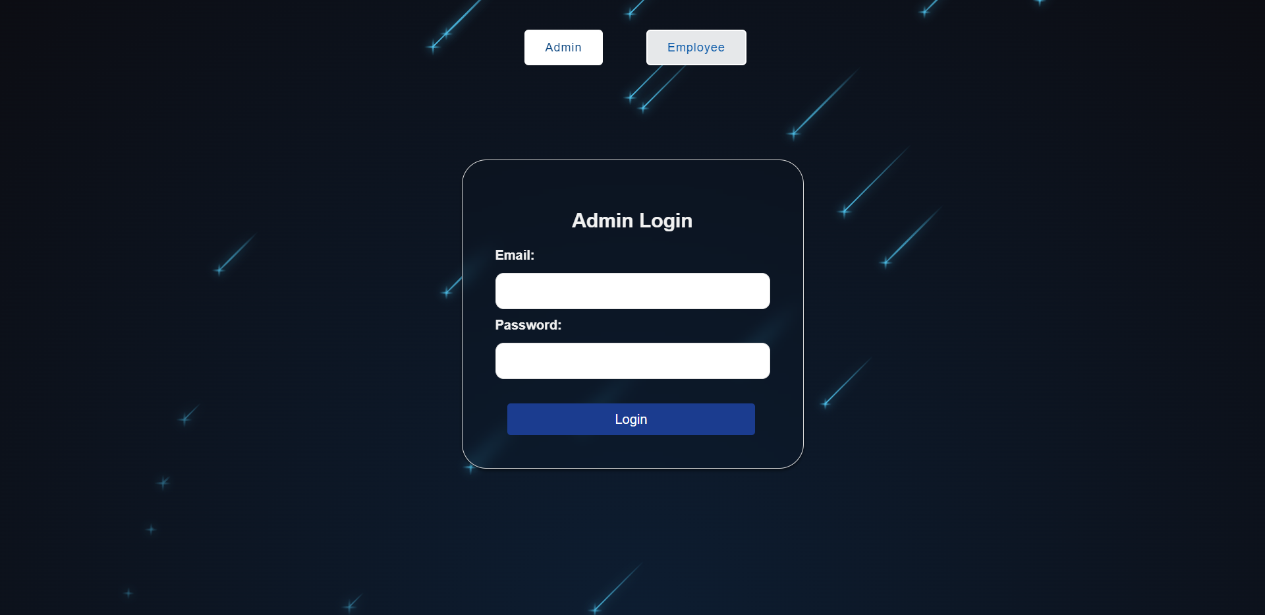
IMAGES
This is the admin Login page ,where the Admin can Login.

Slide 10
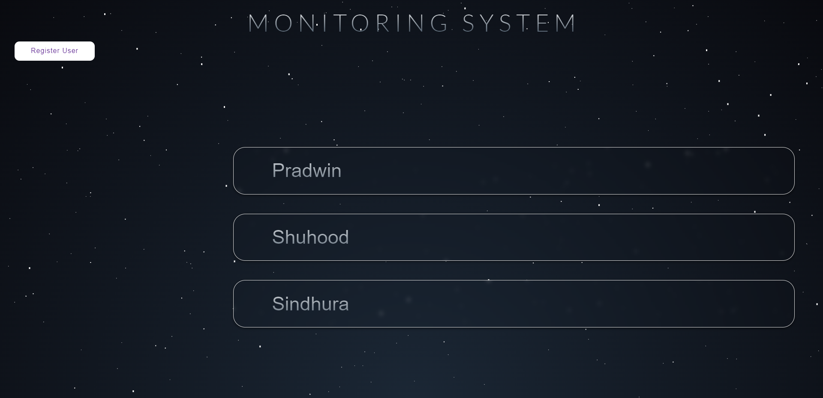
IMAGES
This the page where the admin can monitor the contributions and activity of the Employees.

Slide 11
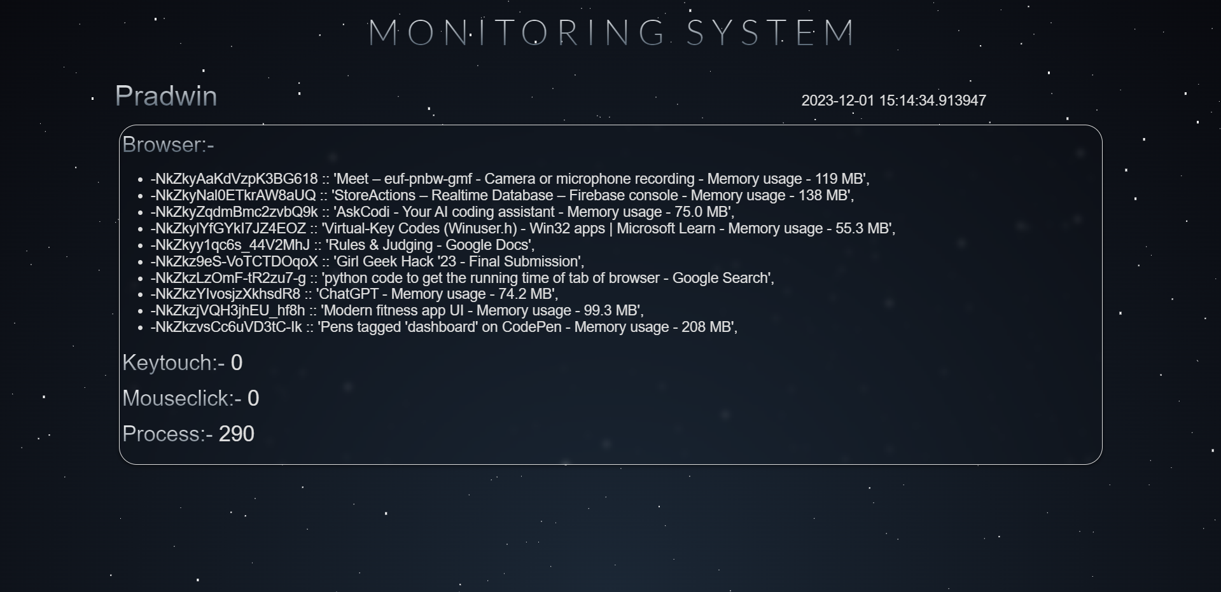
IMAGES
This is a page which shows the activity of a particular Employee,which is accessible only to the admin.

Slide 12
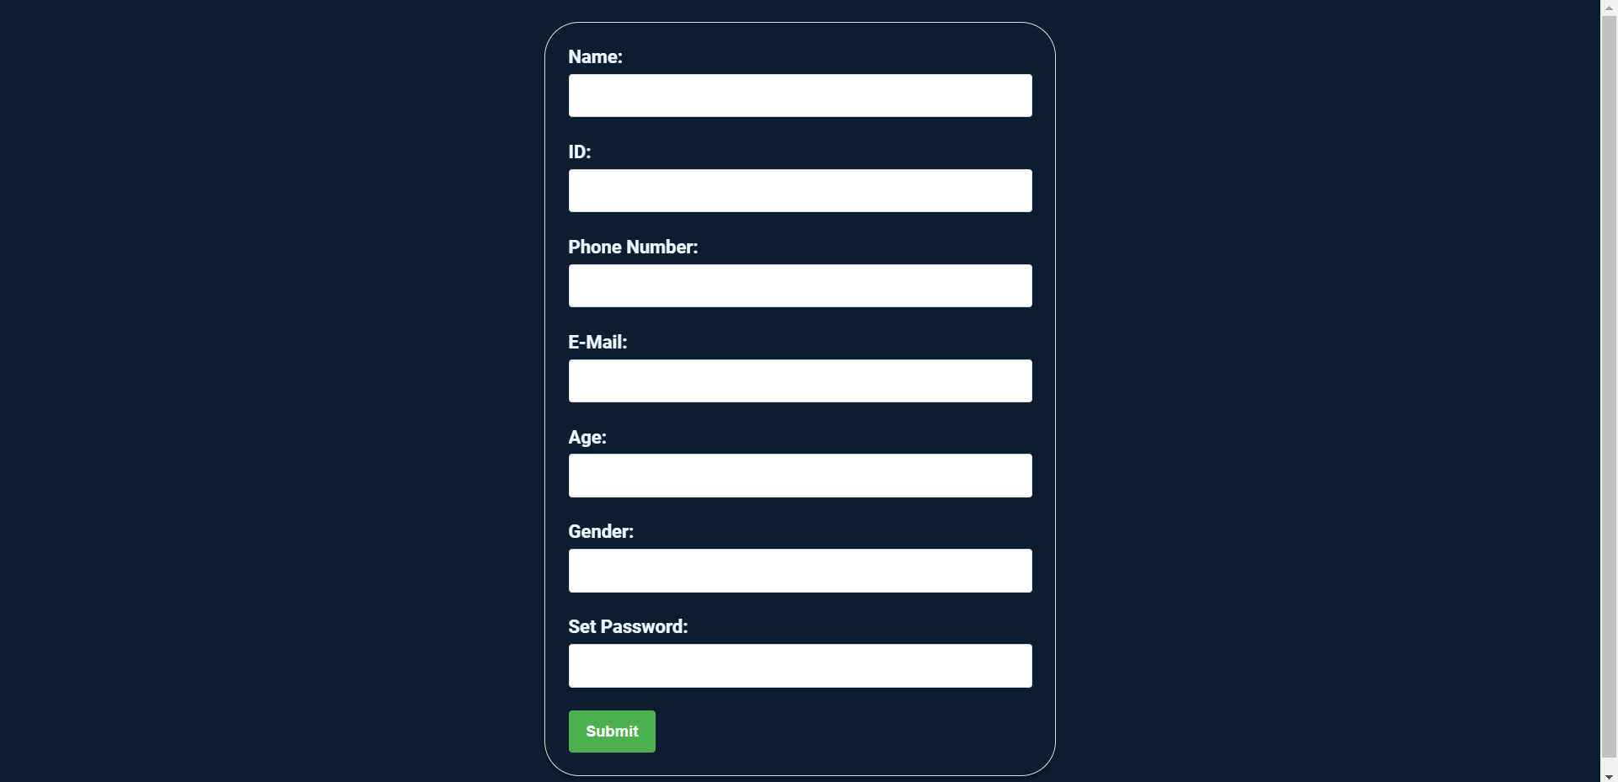
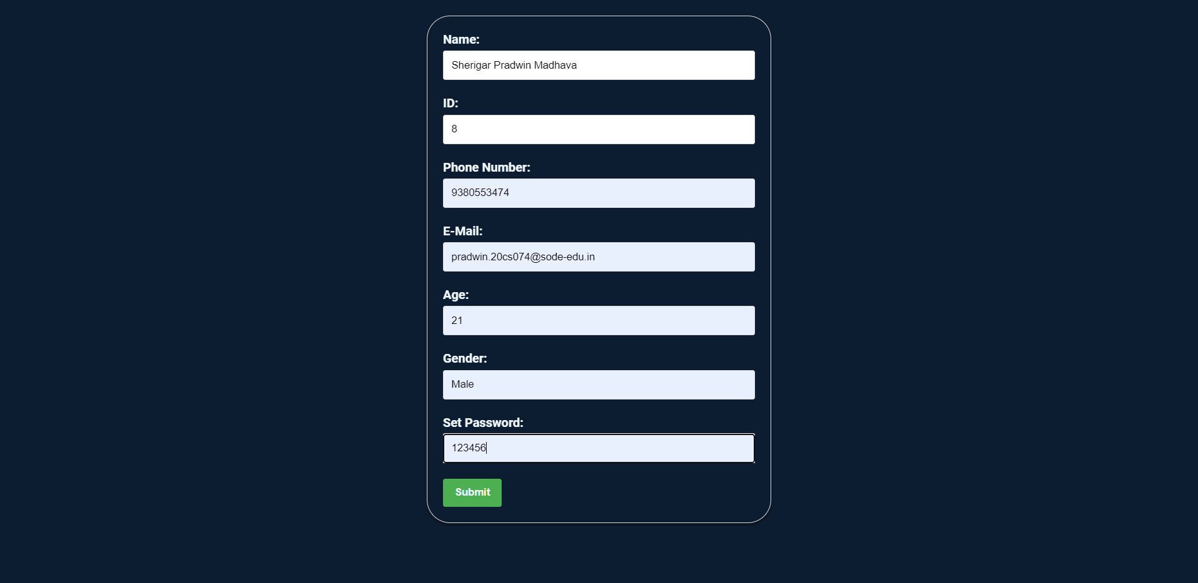
IMAGES
This page is used to register the Employees.

Slide 13
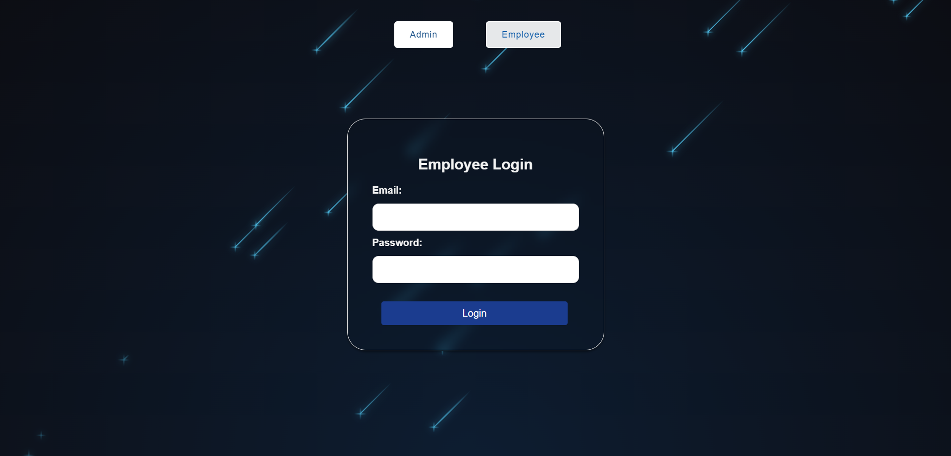
IMAGES
This is the Employee Login page from where the Employees can Login into the website.

Slide 14
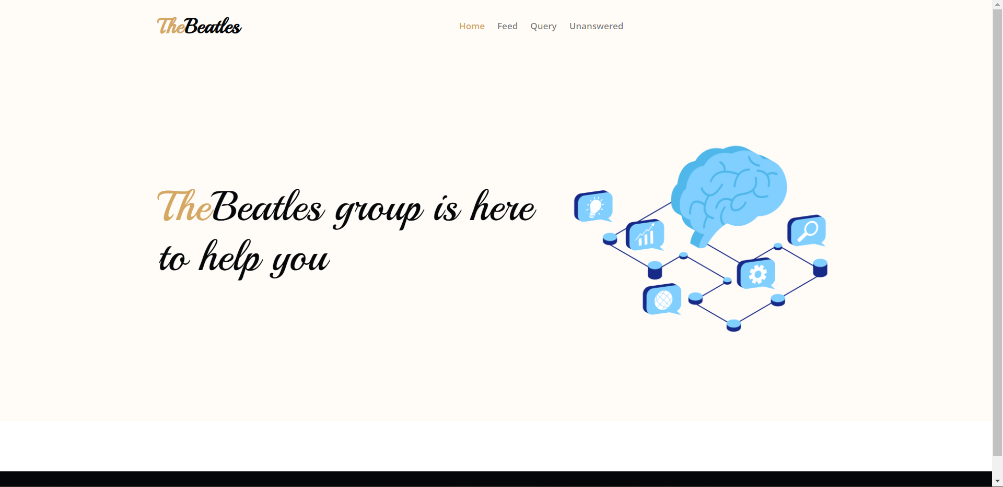
IMAGES
This is main page which gives the company name and info and also the navigation panel.

Slide 15
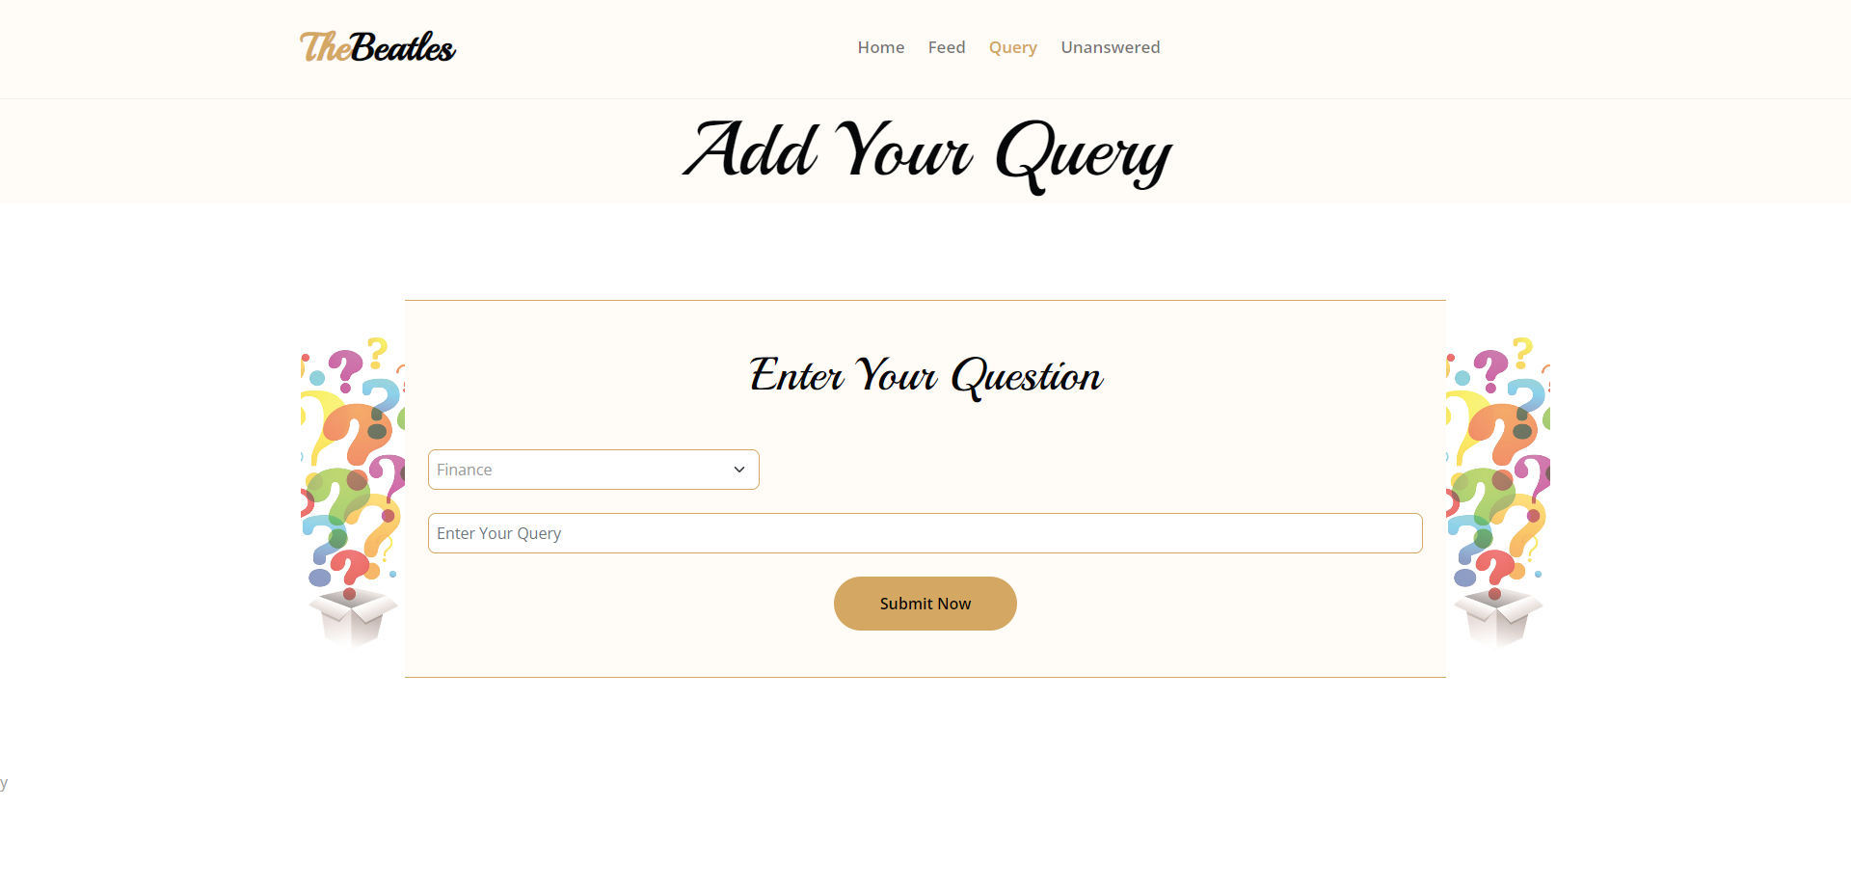
IMAGES
This is the page where we can post our queries.

Slide 16
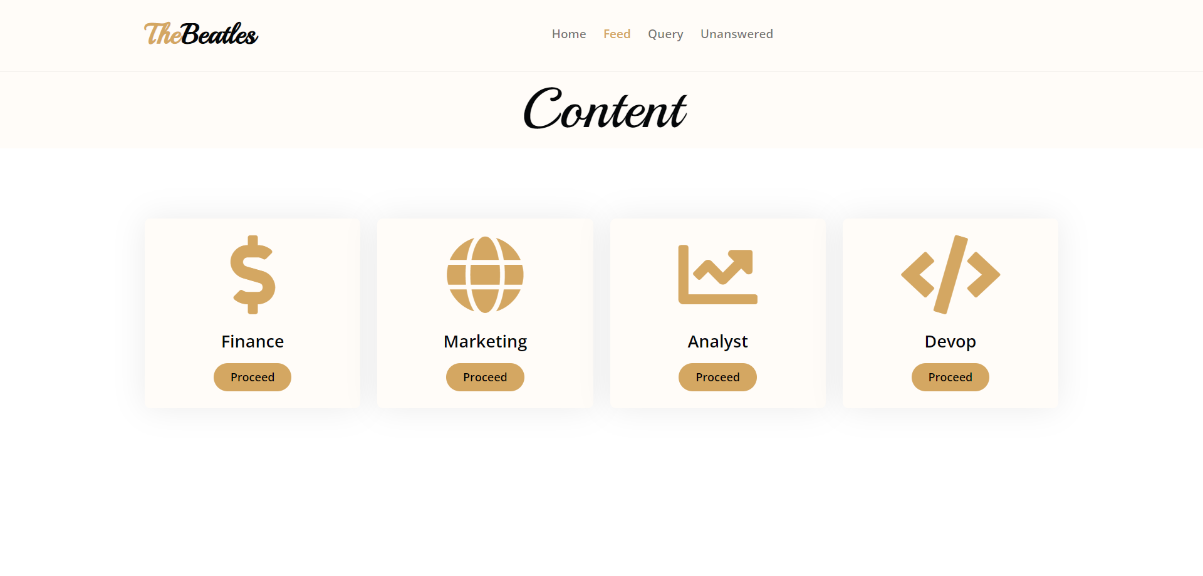
IMAGES
These are the categories under which questions can be asked.

Slide 17
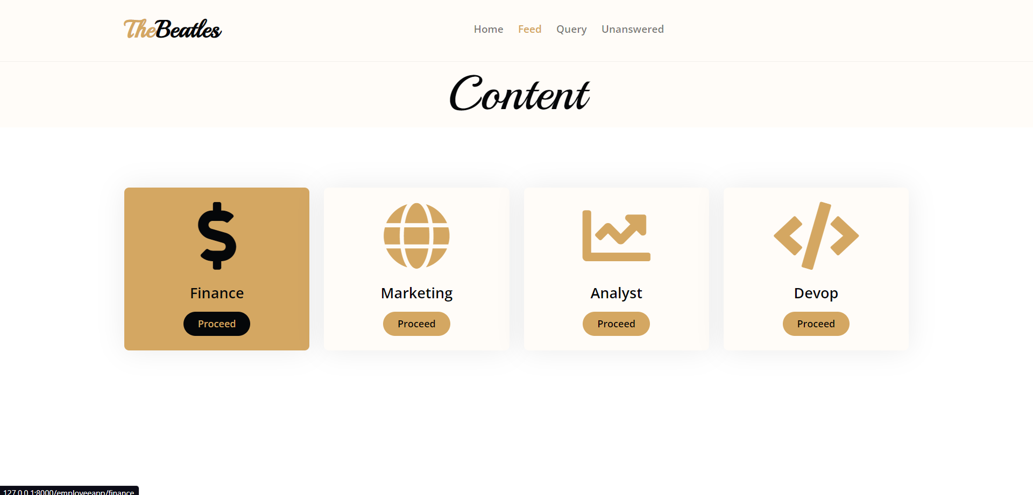
IMAGES
There are 4 type of categories where the user can select and see questions and answer related to it.

Slide 18
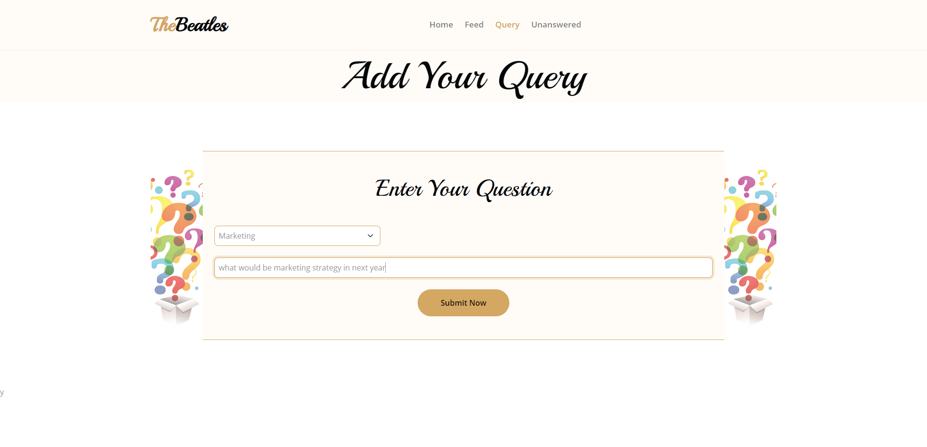
IMAGES
In this a question is asked based on the particular concept.

Slide 19
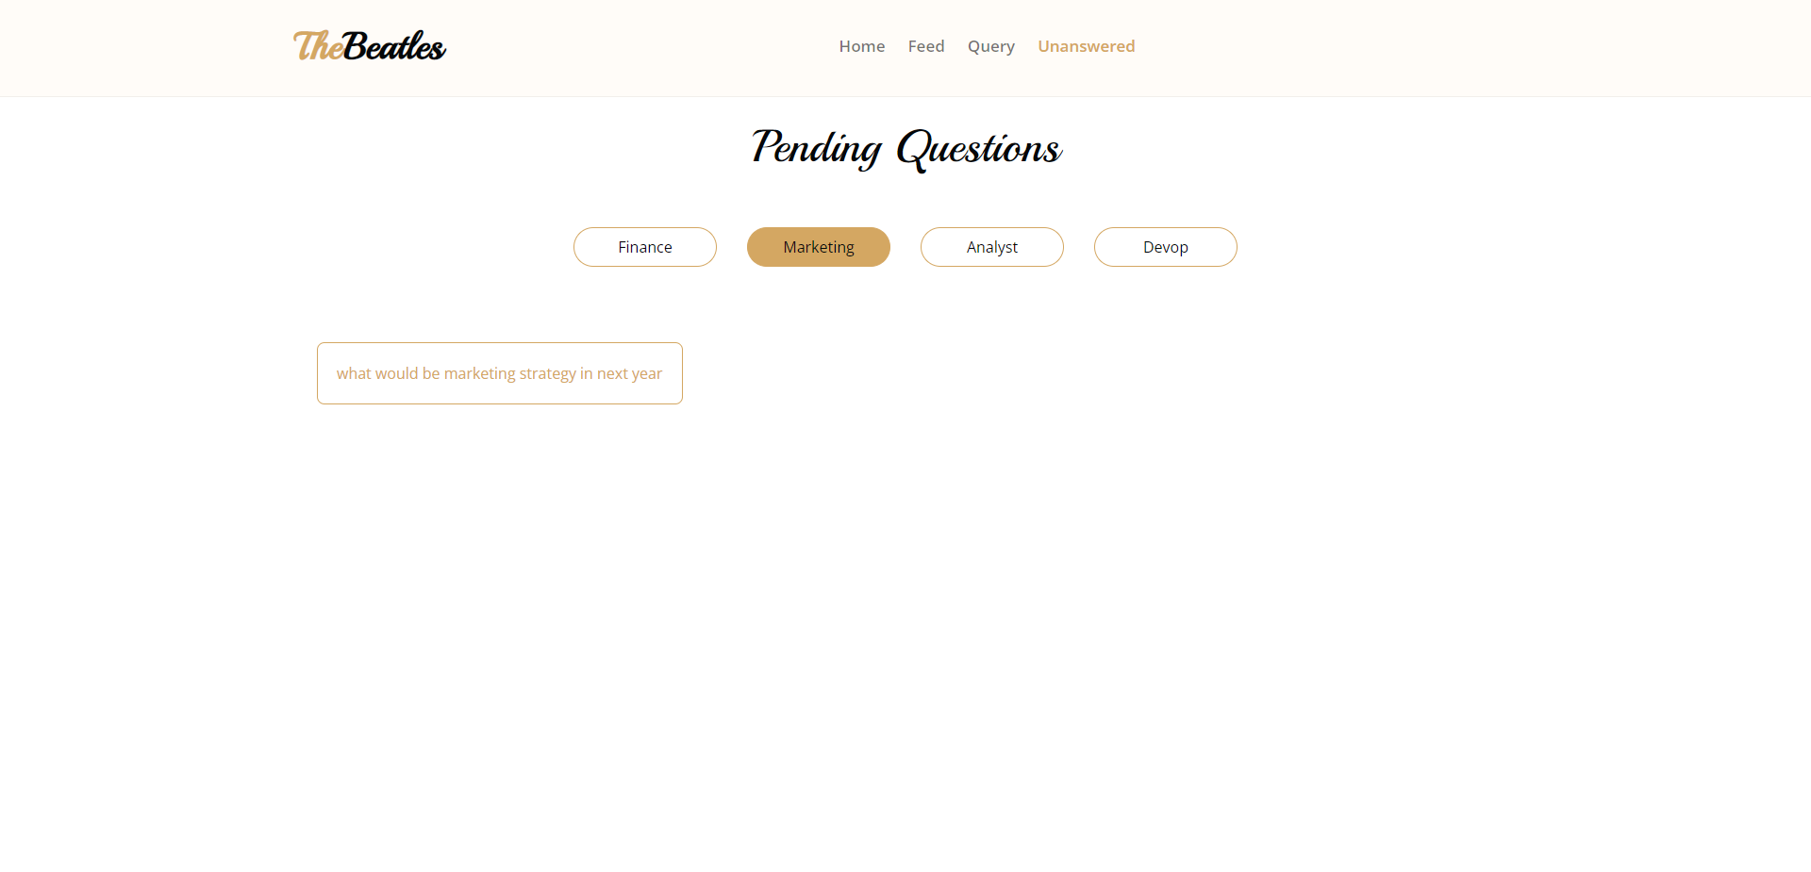
IMAGES
Here we can see all the pending questions.

Slide 20
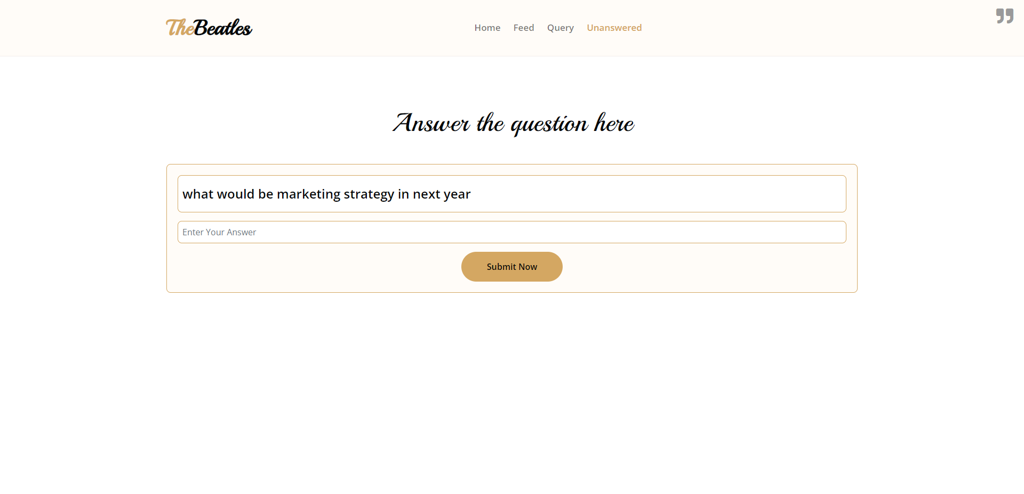
IMAGES
In here other Employees can answer the questions.

Slide 21
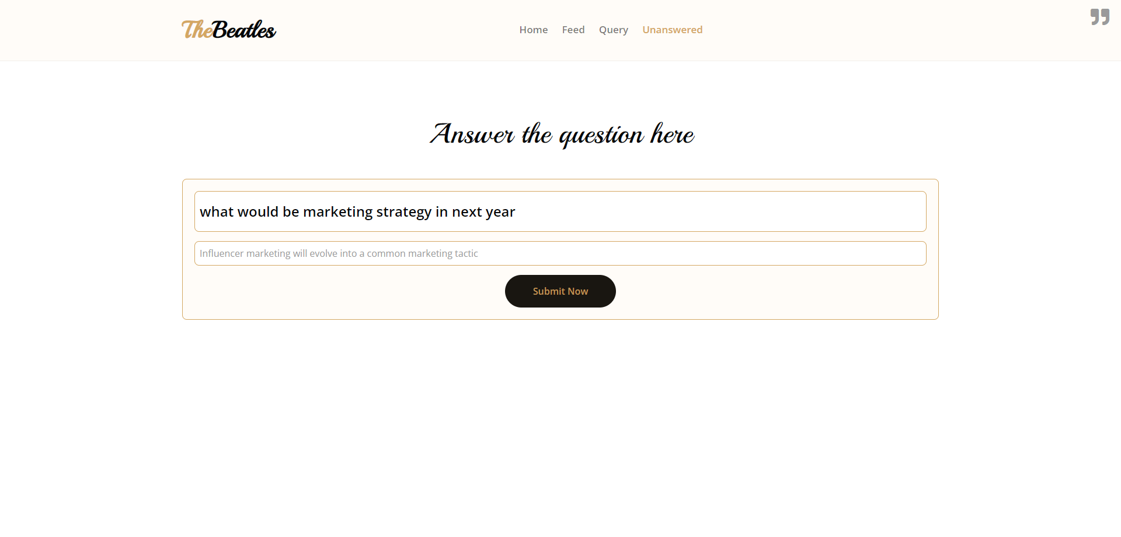
IMAGES
The user can ask the question related to the category

Slide 22
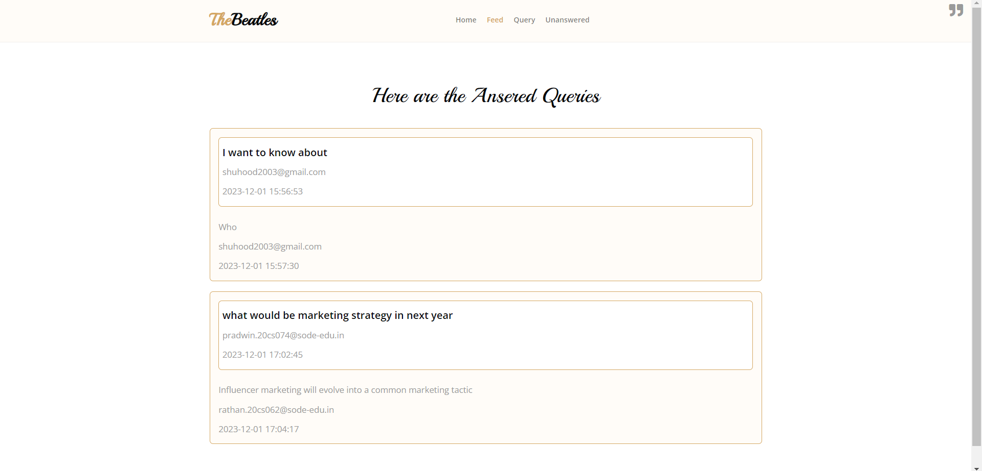
IMAGES
Here we can see the already answered questions.

Slide 23
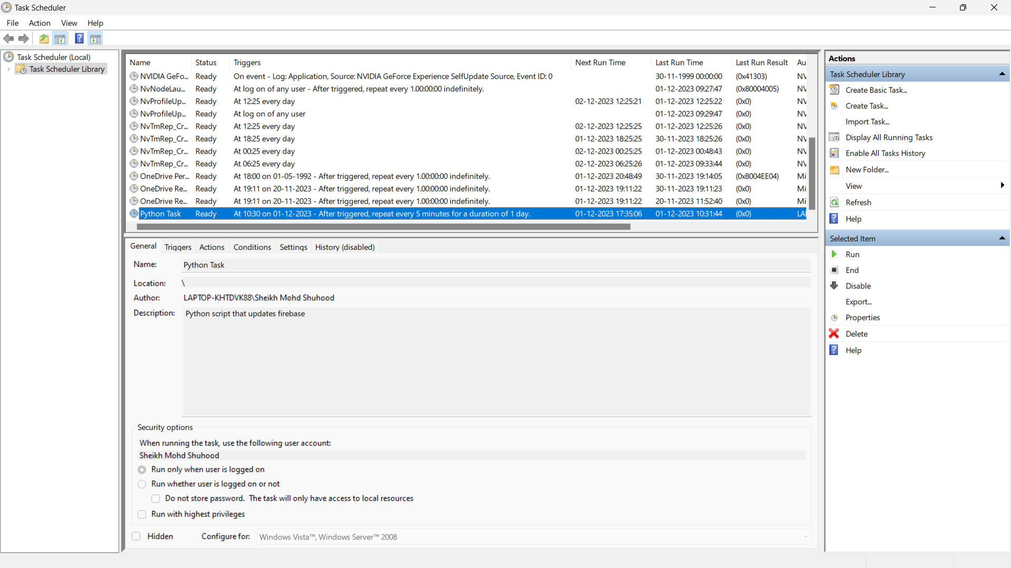
IMAGES
Here we can see that python script which uploads the monitoring info to the database.It can be scheduled

Slide 24
THANKS!
Do you have any questions?
shettysindhu2002@gmail.com
rathannayak300@gmail.com
shuhood2003@gmail.com
pradwinsherigar6931@gmail.com

